Slide 1

Project Title - Seasonal Agriculture Performance Analysis
NAME : Kumpatla Purna chandrama nayudu
AICTE ID :STU6673b2dcf33ca1718858460
Swarnandhra college of engineering and technology

Slide 2

PROBLEM STATEMENT
Agricultural activities are influenced by seasonal variations in environmental conditions, farming practices, resource availability and market conditions. As a result, agricultural performance may differ from one season to another.
However, raw agricultural data does not clearly explain how agricultural performance changes across seasons or what patterns can be observed in different seasonal conditions.
The problem is to analyze the given agricultural dataset and investigate seasonal differences in agricultural performance by identifying meaningful patterns, trends, relationships and variations within the available data

Slide 3
Project Description
This project analyzes 4,000 farm records across 28 variables to understand seasonal differences in yield, production, profitability, water use, environmental conditions, and farming practices. The workflow covers data understanding, cleaning, statistical analysis, univariate and outlier analysis, bivariate and multivariate analysis, seasonal comparison, and additional farm-scale, irrigation, and pest-risk analysis.

Slide 4

WHO ARE THE END USERS?
The notebook does not explicitly define end users. Based on the stated objectives, the analysis is intended to support: • Agricultural decision-makers • Farm and irrigation planners • Agricultural analysts and researchers • Stakeholders comparing seasonal and regional performance

Slide 5

Technology Used
Python — analysis and workflow
Pandas — data loading, cleaning, grouping, and summaries
NumPy — numerical operations
Matplotlib — visualizations
Seaborn — statistical plots and heatmaps

Slide 6
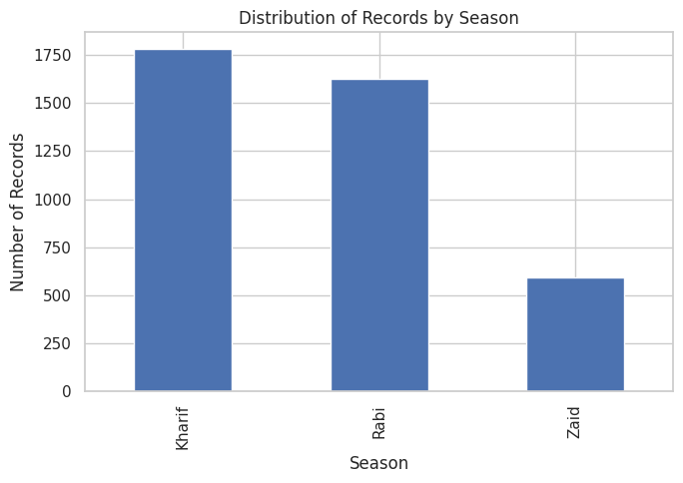
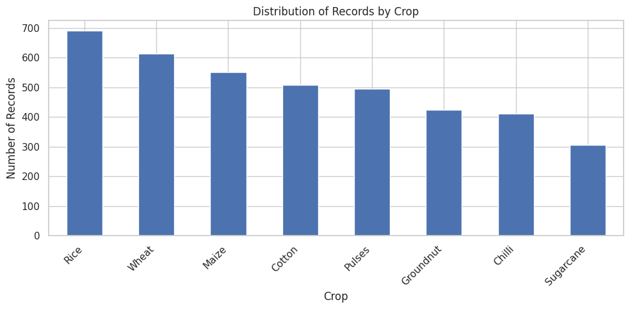
RESULTS
How is the agricultural dataset distributed across different seasons and crops?
Insights
Kharif has the highest number of records, followed by Rabi.
Zaid has considerably fewer records than Kharif and Rabi.
Among crops, Rice has the highest number of records.
Wheat and Maize also have a high number of records.
Sugarcane has the lowest number of records among the crops shown.

Slide 7
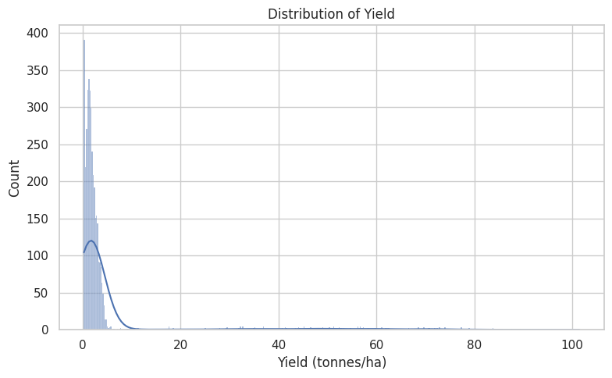
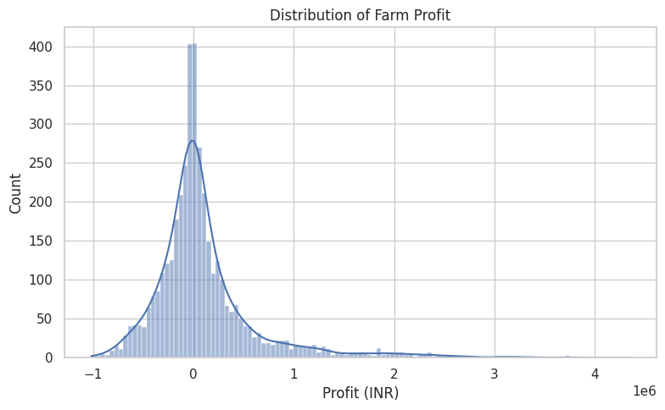
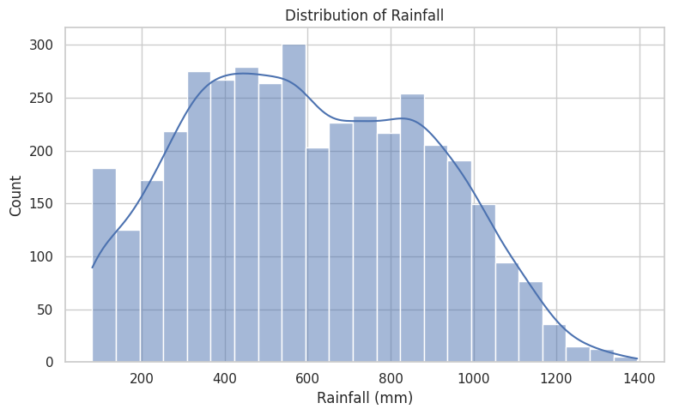
RESULTS
What is the distribution of yield, farm profit, and rainfall in the agricultural dataset?
Insights
Yield: Most observations are concentrated at lower yield values, with a long right tail showing some very high-yield observations.
Farm Profit: Most farms have profit values around ₹0, while the distribution extends toward both losses and high profits.
Rainfall: Rainfall values are spread across a wide range, with most observations roughly between 300–1,000 mm.

Slide 8
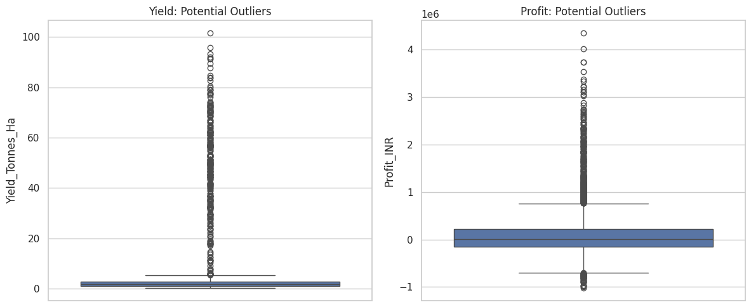
RESULTS
Are there potential outliers in yield and farm profit?
Insights
Yield: The box plot shows many potential outliers, with several observations having much higher yields than the main distribution.
Farm Profit: Profit also contains many potential outliers, including both unusually high profits and some large negative values.
These extreme values indicate high variation in agricultural performance and should be considered during further analysis.

Slide 9
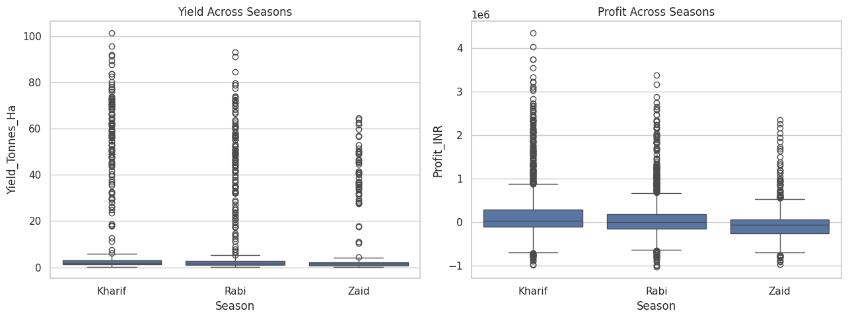
RESULTS
How does agricultural yield and profit vary across different seasons?
Insights
Kharif shows the highest overall yield and profit distribution.
Rabi has a moderate yield and profit compared with Kharif.
Zaid generally shows the lowest yield and profit among the three seasons.
All seasons contain potential outliers, with some farms showing unusually high yields and profits.

Slide 10
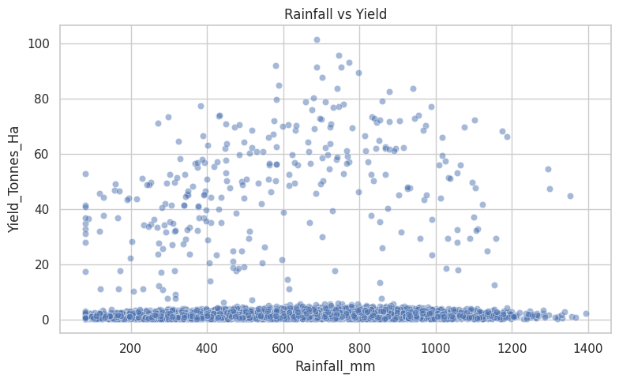
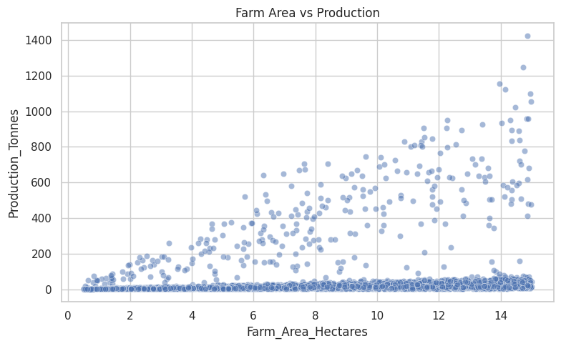
RESULTS
Is there a relationship between rainfall and yield, and between farm area and production?
Insights
Rainfall vs Yield: The plot shows a positive relationship at higher yield levels—yield generally increases as rainfall rises, although there is considerable variation.
Farm Area vs Production: There is a clear positive relationship; larger farm areas generally produce higher total production.
The relationships are not perfectly linear, as the data contains substantial variation and some outliers.

Slide 11
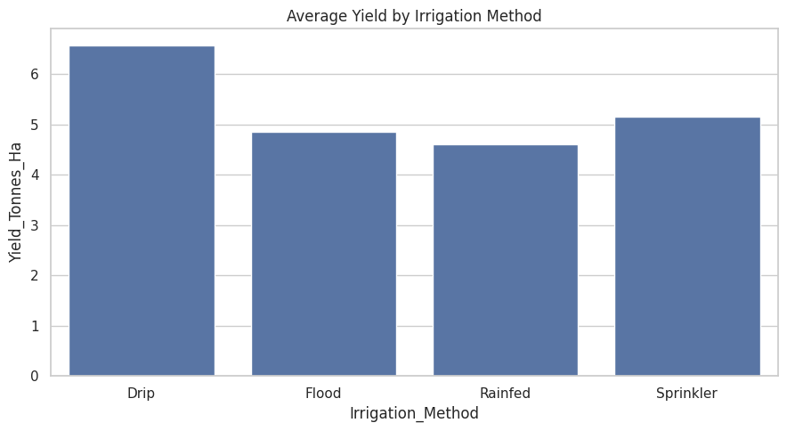
RESULTS
How does average yield vary across different irrigation methods?
Insights
Drip irrigation has the highest average yield, at approximately 6.5 tonnes/ha.
Sprinkler irrigation has the second-highest average yield, at about 5.1 tonnes/ha.
Flood irrigation gives an average yield of around 4.8 tonnes/ha.
Rainfed farming has the lowest average yield, at approximately 4.6 tonnes/ha.

Slide 12
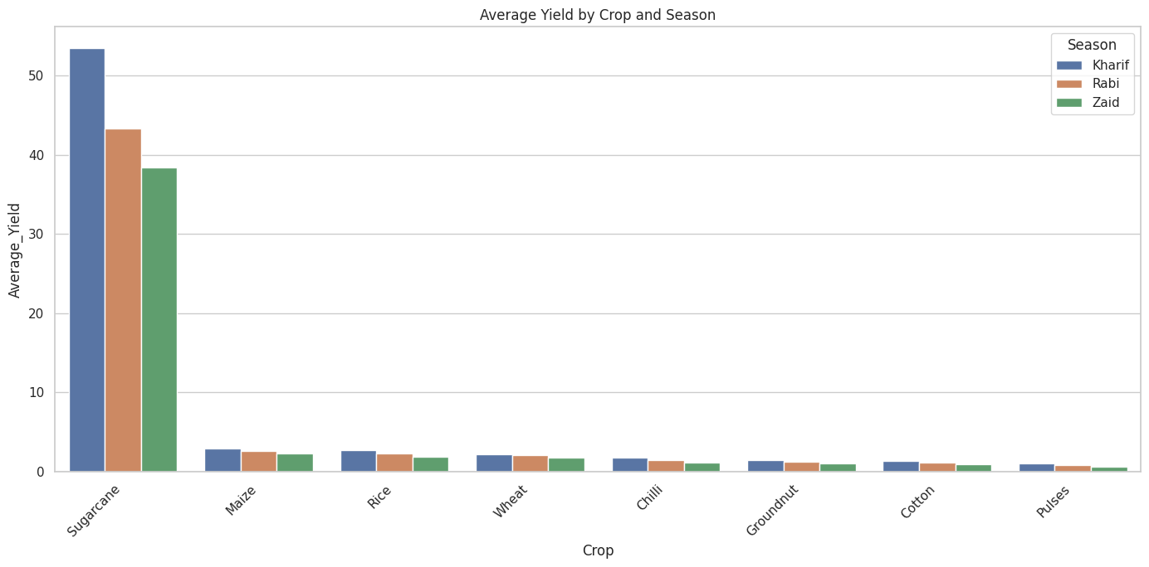
RESULTS
How does average crop yield vary across different seasons?
Insights
Sugarcane has the highest average yield in all three seasons.
Sugarcane performs best in Kharif (~53.5 tonnes/ha), followed by Rabi (~43 tonnes/ha) and Zaid (~38 tonnes/ha).
For most other crops, Kharif has the highest average yield, followed by Rabi and Zaid.
Pulses have the lowest average yield among the crops shown.

Slide 13
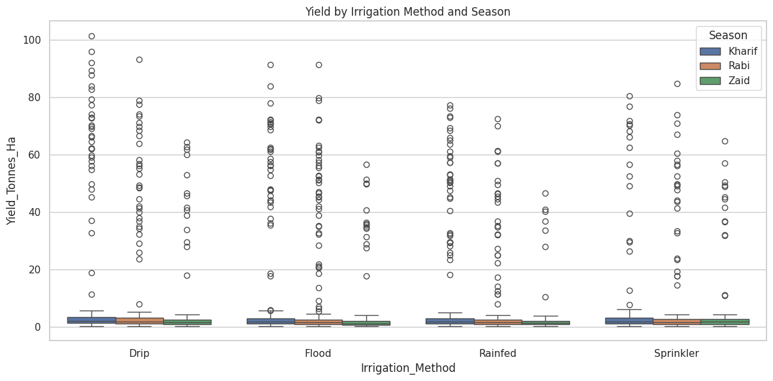
RESULTS
How does yield vary across different irrigation methods and seasons?
Insights
Drip irrigation shows the highest yield levels across the seasons.
Sprinkler also shows relatively higher yields compared with Flood and Rainfed in several observations.
Flood and Rainfed generally show lower yield distributions.
Yield varies considerably within each irrigation method, with several high-yield outliers.

Slide 14
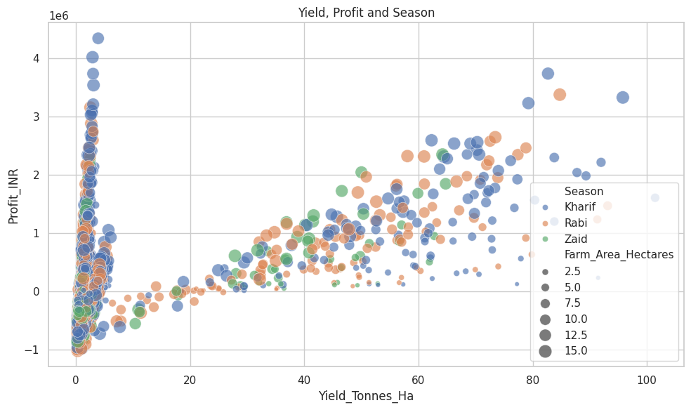
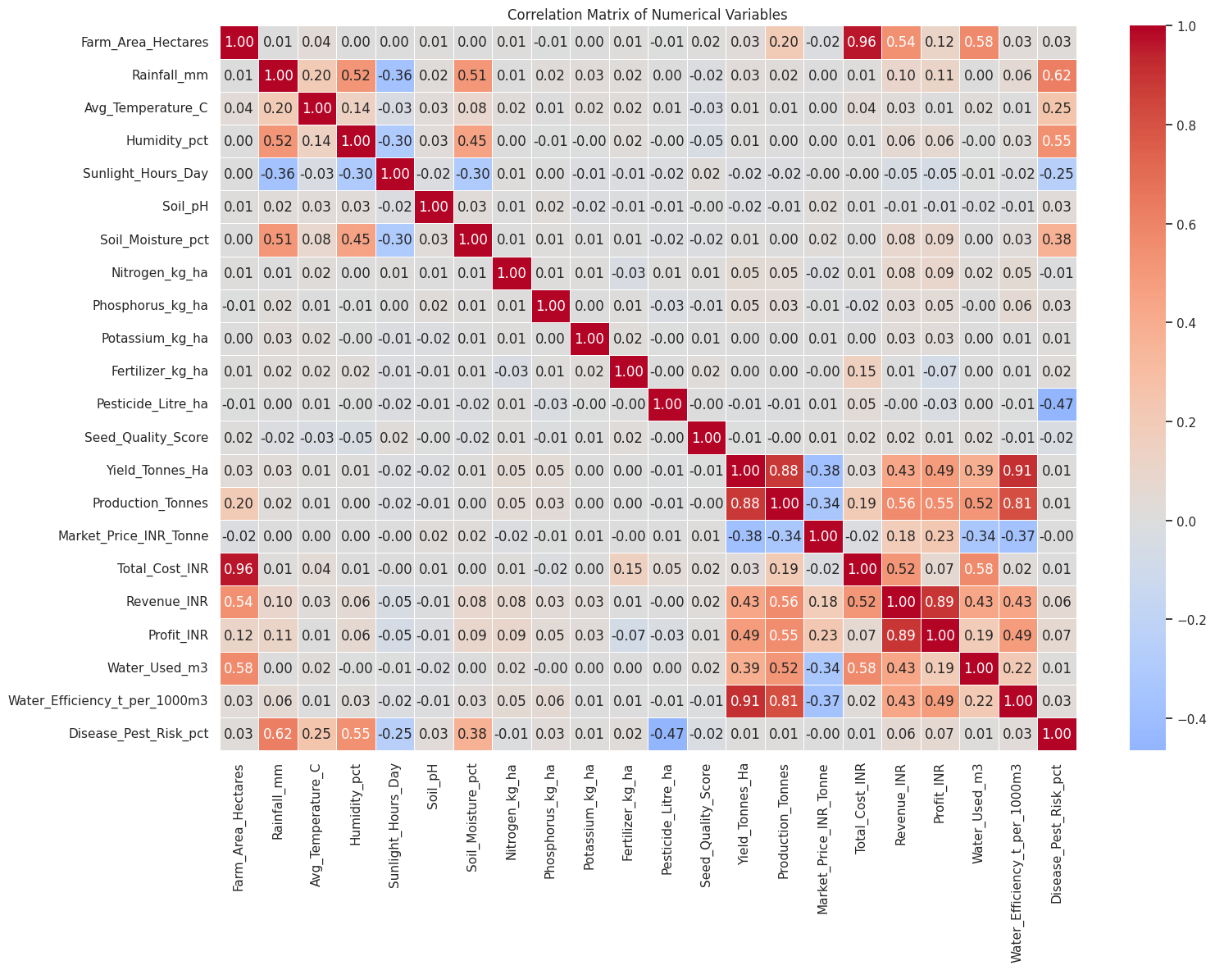
RESULTS
What relationships exist between yield, profit, farm size, and other agricultural variables across different seasons?
Insights
Yield and profit show a positive relationship.
Yield and production have a strong positive correlation (0.88).
Profit and revenue have a strong positive correlation (0.89).
Larger farms generally have higher production.
Rainfall and soil moisture are positively related (0.51).

Slide 15
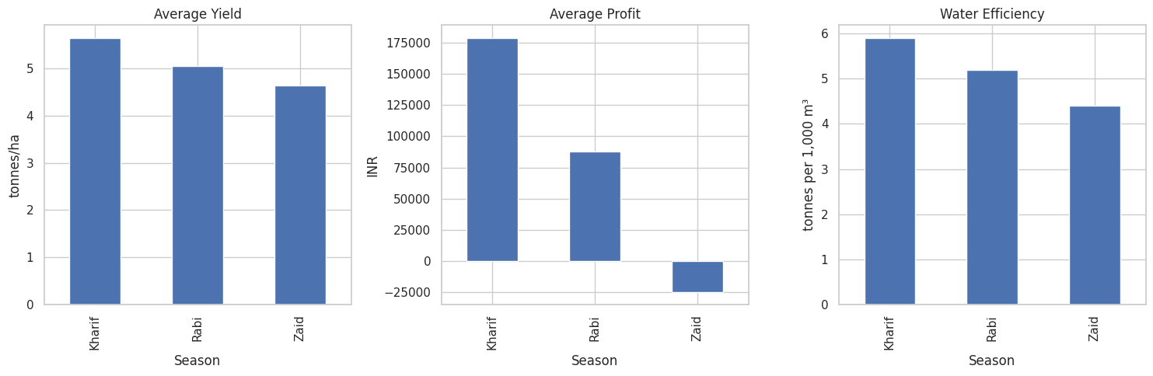
RESULTS
How do average yield, profit, and water efficiency vary across seasons?
Insights
Kharif has the highest average yield and profit.
Rabi shows moderate yield and profit.
Zaid has the lowest yield and negative average profit.
Kharif also has the highest water efficiency, followed by Rabi and Zaid.

Slide 16
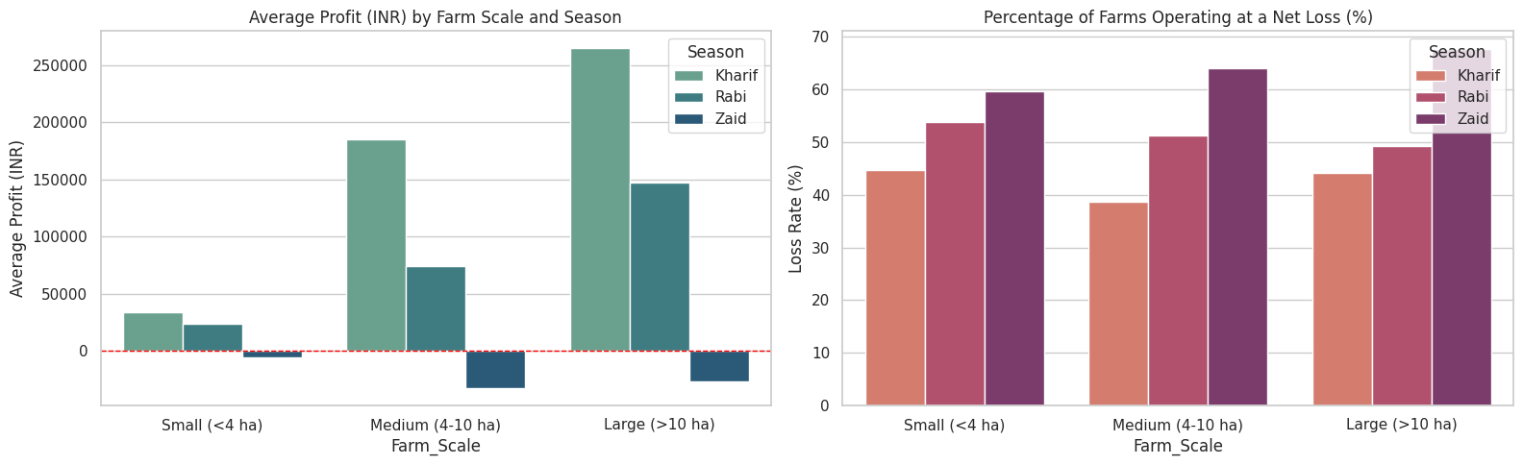
RESULTS
How do farm size and season affect average profit and the percentage of farms operating at a net loss?
Insights
Kharif has the highest average profit across all farm sizes.
Zaid has negative average profit across all farm sizes.
Larger farms generally have higher profits.
Zaid has the highest loss rate, reaching about 64% for medium farms.
Loss rates remain significant across all farm sizes and seasons.

Slide 17
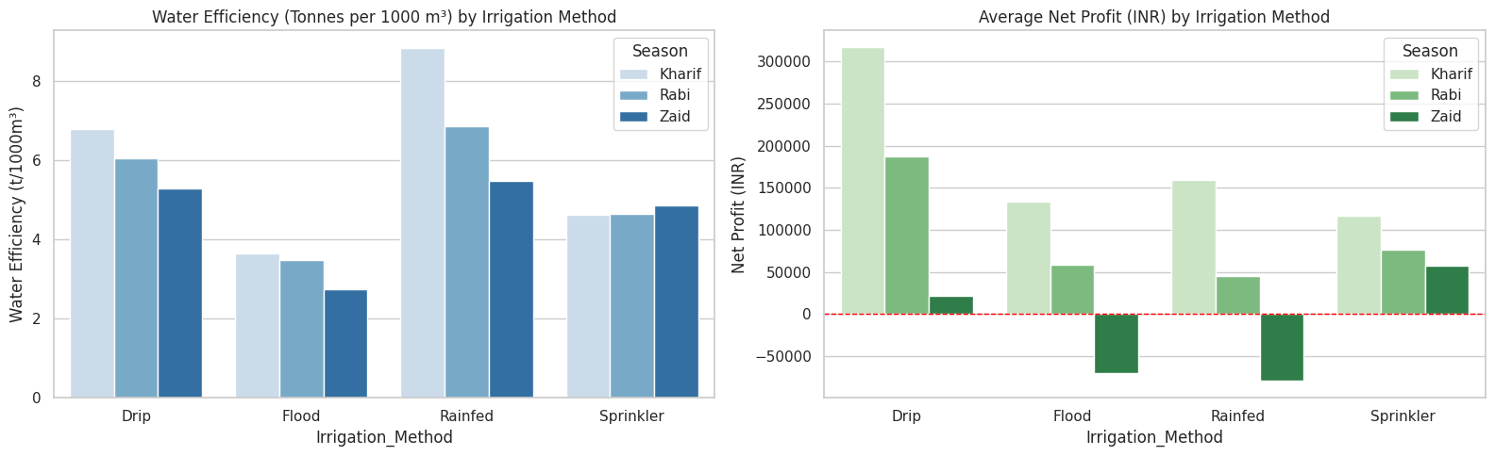
RESULTS
How do irrigation methods affect water efficiency and average net profit across seasons?
Insights
Rainfed Kharif has the highest water efficiency at about 8.8 t/1,000 m³.
Flood irrigation has the lowest water efficiency across all seasons.
Drip irrigation gives the highest net profit in Kharif and Rabi.
Zaid shows negative net profit for Flood and Rainfed irrigation.
Overall, irrigation method and season both affect water efficiency and profitability.

Slide 18
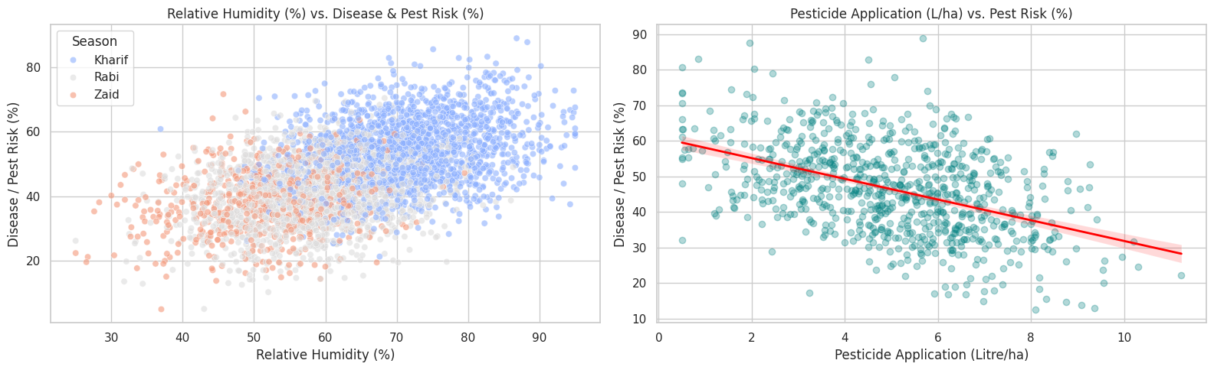
RESULTS
How are humidity and pesticide application related to disease and pest risk across seasons?
Insights
Higher humidity is generally associated with higher disease and pest risk, especially in Kharif.
Pest risk tends to decrease as pesticide application increases, as shown by the downward trend line.
Kharif generally shows higher humidity and pest risk than Rabi and Zaid.
The relationship between pesticide use and pest risk is not perfectly linear, with considerable variation in the data

Slide 19
Future Scope
Interactive Dashboard: Develop a dashboard to monitor seasonal yield, profit, irrigation, rainfall, and pest-risk trends.
ML-Based Prediction: Build machine-learning models to predict crop yield and farm profit using season, crop, rainfall, irrigation, farm size, and other available factors.
Risk Prediction: Develop a model to identify farms with high disease/pest risk or potential financial loss.
Seasonal Decision Support: Use the dashboard and ML predictions to support crop selection, irrigation planning, and seasonal agricultural decisions.

Slide 20
GitHub Link
GitHub link : https://github.com/chandukumpatla/Seasonal-Agriculture-Performance-Analysis

Slide 21
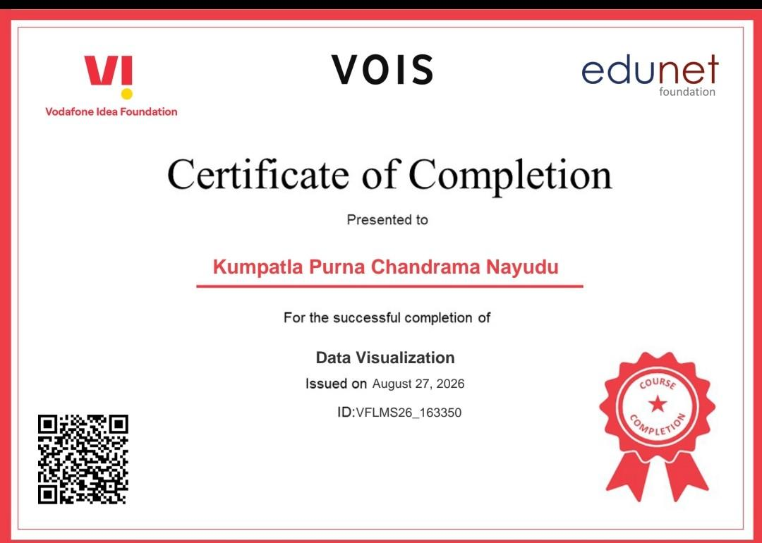
VOIS Course Completion Certificate Course name — Data Visualization

Slide 22
Thank you
.
-kumpatla Purna chandrama nayudu

